Slide 1

The Power of Data to Empower Schools
July 2019

Slide 2
Today’s Objectives/Agenda
Participants will:
Build an understanding of WHY we do the work of school improvement (30 minutes)
Identify the purpose, composition of and scope of work of an ILT (50 minutes)
Identify the Steps and Phases of the Data Wise improvement process (50 minutes)
Articulate how the Data Wise Norms, Rolling Agenda, and ACE Habits of Mind support the work of improvement (Step 1) (50 minutes)
Practice the Data Wise Norms, Rolling Agenda, and ACE Habits of Mind (Step 1) (60 minutes - will be done in team meetings after lunch)

Slide 3
RCSD Meeting Norms
Take an inquiry stance
Ground statements in evidence
Assume positive intentions and take responsibility for impact
Stick to protocol and hear all voices
Start and end on time
Be here now
Expect non-closure
Expect discomfort in the service of learning

Slide 4
School Improvement
WHY - Who am I and what do I believe about equity and school improvement?
WHAT - Using the Instructional Core to guide school improvement efforts
WHO - Instructional Leadership Teams guiding school improvement
HOW - The Data Wise Improvement Process
Notes:
This slide represents the “flow” for the day. We will start by exploring why we do the work of school improvement, move into the “What” - what do we need to examine to promote school improvement - the instructional core. Then we will take a look at Instructional Leadership Teams - the “Who” of school improvement. This group will begin to support the work at the building levels. Finally, we will take a look at a research-based improvement process that ILTs can use to support this work - the “How” - which is the Data Wise Improvement process.

Slide 5
Why - Equity
An equitable school is one where: Student outcomes are not predictable by demographic data Students feel respected and celebrated for who they are
To accomplish this, educators use equitable practices, including: Holding all students to high standards Adjusting instruction so all students can learn Taking stock of own identities, assumptions, and biases Actively interrupting patterns of inequity
Notes:
As we take a deeper look at levers for school improvement today, it is important that we address the connection between school improvement and equity. When we implement processes to improve schools, it is important to keep equity in the forefront of the work and move towards the objectives, mindsets, and behaviors in this slide.

Slide 6
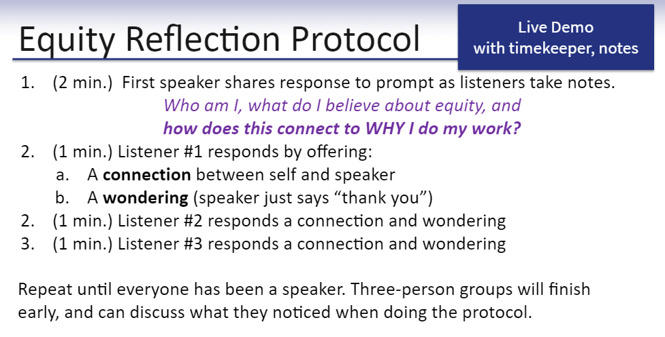
Notes:
Please take part in this protocol to investigate our personal “why” and make some connections with the group.

Slide 7
School Improvement
WHY - Who am I and what do I believe about equity and school improvement?
WHAT - Using the Instructional Core to guide school improvement efforts
WHO - Instructional Leadership Teams guiding school improvement
HOW- The Data Wise Improvement Process

Slide 8
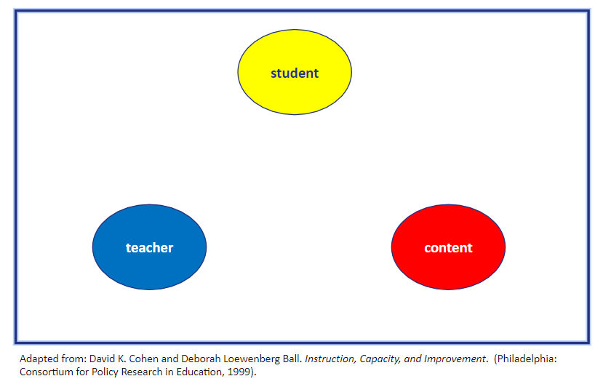
WHAT - The Instructional Core
Notes:
Since school improvement is all about improving student learning, it is important for us to pay very close attention to the place where learning happens in schools.
The instructional core is a framework that helps us understand this place. How many people are familiar with the term “the instructional core?” Please get out the instructional core handout.
The framework was first introduced by David Cohen and Deborah Loewenberg Ball in 1999 paper.
It has been widely cited in the intervening years, including in the Data Wise book (page 114), and it is the subject of the whole first chapter of the Instructional Rounds book.
The core is what we have to improve if we want student learning to improve - therefore we must examine the core when we examine data.
The framework posits that there are three critical components in the place where learning happens. If you want to improve student learning, you need to think about what the student is doing, what the teacher is doing, and what the content of the lesson is

Slide 9
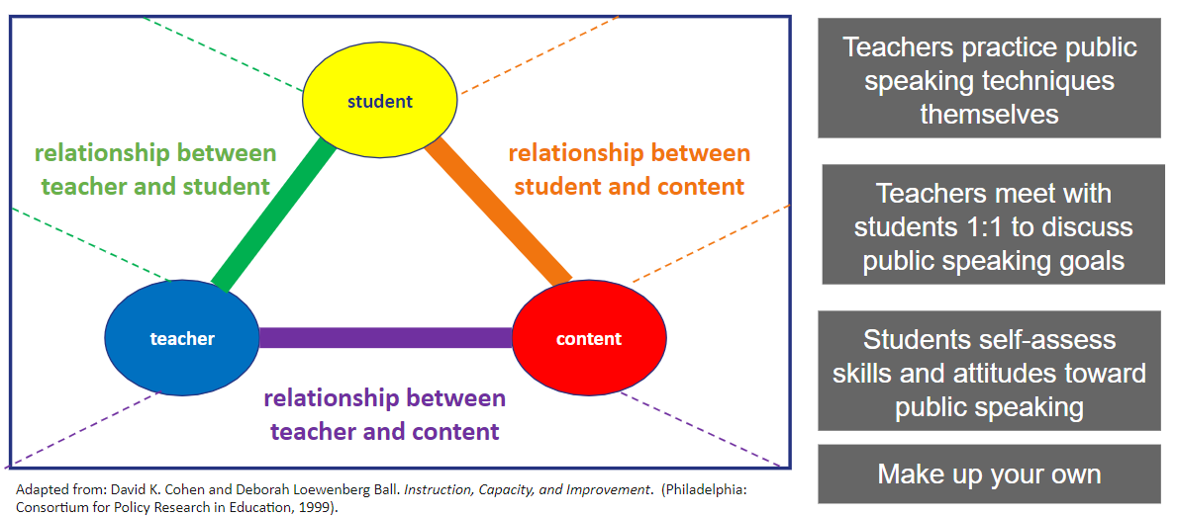
What - The Instructional Core
Notes:
(3 minutes) Have pairs discuss where statements belong on the core, and create their own statements if they have extra time
(2 minutes) Show where the statements go on the core

Slide 10
School Improvement
WHY - Who am I and what do I believe about equity and school improvement?
WHAT - Using the Instructional Core to guide school improvement efforts
WHO - Instructional Leadership Teams guiding school improvement
HOW - The Data Wise Improvement Process

Slide 11
WHO - Instructional Leadership Teams (ILTs)
“School leaders have the greatest effect on student learning when they identify strong teachers with diverse backgrounds and expertise and develop them into a high functioning community of instructional leaders.”
-Breakthrough Principals (2016)
Notes:
Most schools currently have structures in place that are similar to Instructional Leadership Teams. Our work around the implementation of ILT’s begins with building consistent understanding of the make-up and the role of the ILT. The information that will be presented today comes from the book “Breakthrough Principals” which was co-authored by Dr. Aquino and research from the Aspen Institute.

Slide 12
ILTs- Purpose
Guide the work of school improvement
Increase collaboration and distributive leadership
Ensure consistency of instructional vision school-wide
Provide guidance, grounded in evidence, about the school’s instructional program
Guide school improvement through processes including the Data Wise Improvement Process and implementation of the Instructional Learning Framework

Slide 13
What an ILT IS
Feeds into similar structure for Grade Level/Department Teams
A place where divergent ideas are heard and leadership is shared
Unique to each school
Knowledgeable about how students learn
Knowledgeable about the content and rigor expected in the standards
A model of a professional learning community. Identifies and seeks training as a team
Fully committed to the implementation of New York State and National Standards and the Instructional Learning Framework
Representative of all staff groups including Teachers, Administration, and instructional support staff (Special Education, ESOL)
Centered on teaching and learning/ Deals only with instructional issues
Focused on student achievement for all

Slide 14
What an ILT IS NOT
Responsible for the day-to-day operations of the school (though they may make suggestions)
An elite group
Composed of only those who happen to be available
Additional responsibilities for an existing committee
Dominated by one person or group
Notes:
Questions about “elite group”? Not privileged, but aren’t these stronger teachers? we need to discuss before Wednesday...

Slide 15
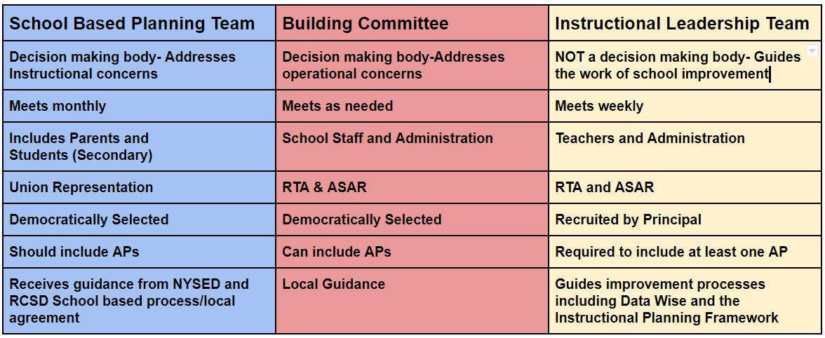
ILTs, SBPT, and BC

Slide 16
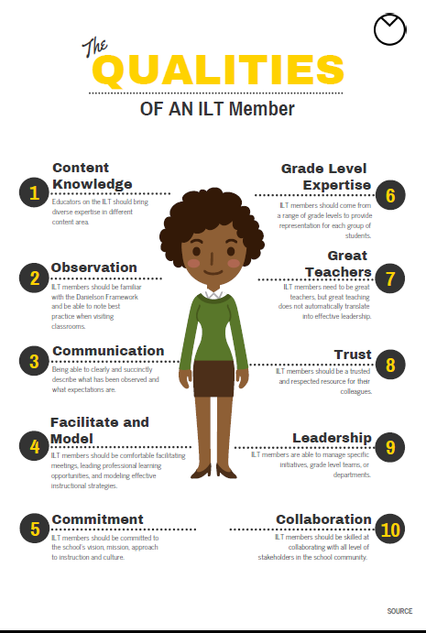
Who Sits on an ILT?
Principal
Assistant Principal
Teacher Leaders
*Research has found a team size of 8-10 members is ideal
Notes:
Review Handout- Activity?

Slide 17
ILTs - Action Steps
Stage 1 (July-September 2019)
Building leaders introduce and define ILT to staff
Selection of ILT members
Create a shared vision for teaching and learning (August/September)
Establish meeting structures (dates/times)
Review School Level Data (August/September)
Stage 2 (July-December 2019)
All schools will hold weekly meetings
Co-construct professional learning plan for the ILT including the Data Wise Improvement Process
Develop a system for communication among ILT and Grade Level/Content Area Teams
Stage 3 (January-June 2020)
Build systems for distributed leadership
Continuous progress monitoring of ILT process

Slide 18
ILT Feedback
Please take a few minutes to discuss with your team
3 Things that excite us about ILT’s
2 Wonderings we have about ILT’s
1 Step we will take toward creating an ILT
Notes:
Green paper feedback note catcher

Slide 19
BREAK
(10 minutes)
Notes:
10:15

Slide 20
School Improvement
WHY - Who am I and what do I believe about equity and school improvement?
WHAT - Using the Instructional Core to guide school improvement
WHO - Instructional Leadership Teams guiding school improvement
HOW - The Data Wise Improvement Process

Slide 21
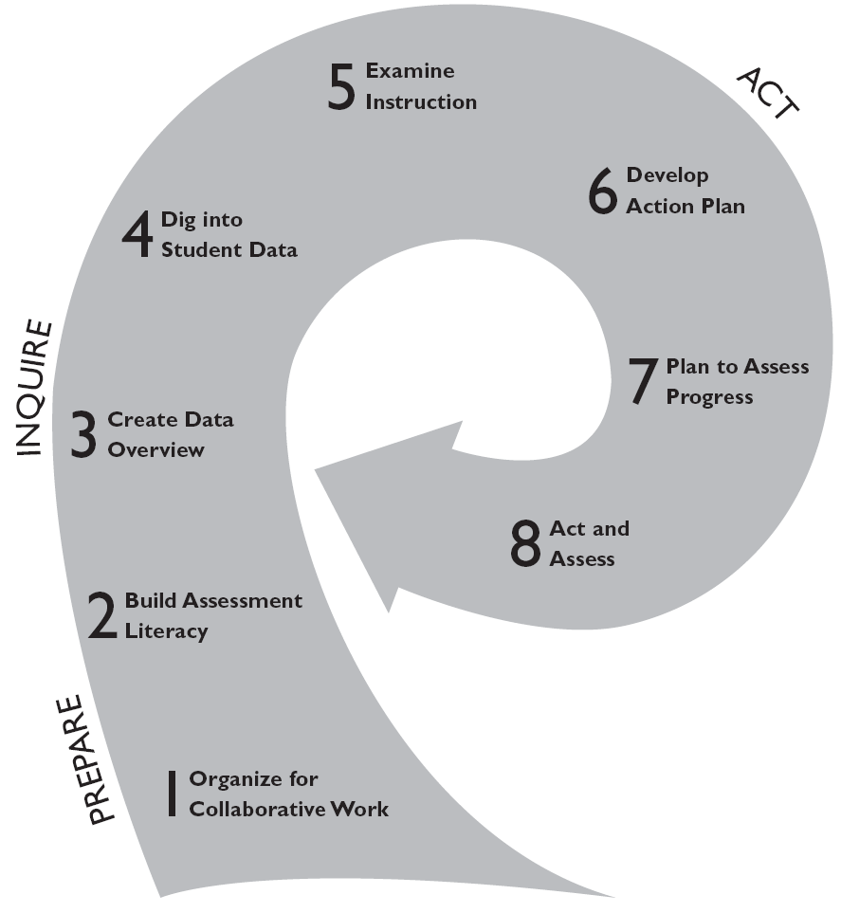
Overview of the DataWise Process
“Data Wise is not a program to implement, a set of assessments, or a platform for storing data. Instead, it’s a systematic approach to organizing the core work of schools around instructional improvement. And this happens by keeping conversation squarely focused on evidence of student learning.”
Kathy Boudett, Director of the Data Wise Project
Notes:
So, when we think about the “How” of school improvement, DataWise has been identified as a process to use. The Data Wise process allows ILTs a structured way to examine student data and the instructional core. While parts of the process examine student data, other parts of the process examine instruction….. but underpinning of the ENTIRE process includes intentional, purposeful collaboration. Professional Learning will continue throughout the year during Principal Meetings and other learning opportunities
Called the swoosh

Slide 22
Data Wise- Is/Is Not
What Data Wise IS | What Data Wise IS NOT
Inquiry- Questions drive learning and next steps | Declarative- Stating what has to be done
Collaborative- all staff have a voice in determining what actions to take and what questions to explore | Directive- one person decides what happens in isolation
Designed to create spaces for learning about instruction, assessment, and practice for everyone | A process that assumes skill and knowledge exist without having evidence of intentional knowledge and skill development.
Notes:
It is important to note that Data Wise underscores the power of inquiry and collaboration to promote improvement and growth - but it is not a panacea. These slides highlight qualities of the process and delineate what the process IS and IS NOT.
TURN AND TALK - What do you notice? What do you wonder?

Slide 23
Data Wise- Is/Is Not
What Data Wise IS | What Data Wise IS NOT
Means of organizing and bringing coherence to staff members’ collective efforts at improvement | A program to implement
A means to help school leaders organize the work of school improvement around a process that has specific, manageable steps | A compliance measure or a checklist to be completed
Cyclical; recursive | A linear process that doesn’t allow for assessment and adjustment
A series of yearlong coherent inquiry meetings | A singular meeting (collaborative planning, data utilization, analyzing student work, etc.)
Notes:
It is important to note that Data Wise underscores the power of inquiry and collaboration to promote improvement and growth - but it is not a panacea. These slides highlight qualities of the process and delineate what the process IS and IS NOT.
TURN AND TALK - What do you notice? What do you wonder?

Slide 24
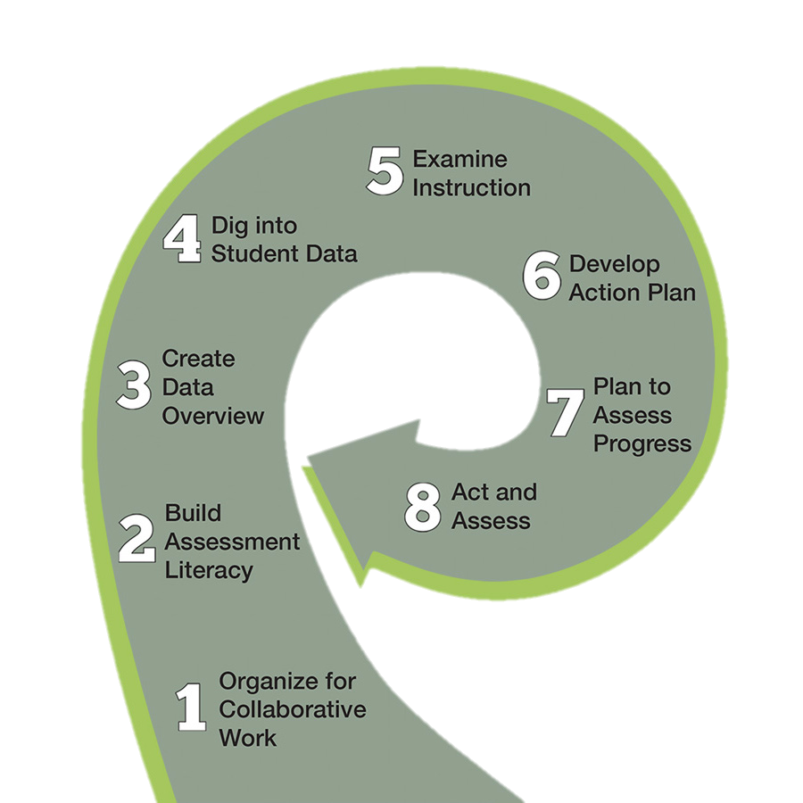
Overview of the DataWise Process
{
Inquire
LEARNER-CENTERED
PROBLEM
PROBLEM OF
PRACTICE
}
PRIORITY
QUESTION
ACTION
PLAN
{
GREATER COMFORT WITH DATA
PLAN TO ASSESS
PROGRESS
Prepare
Act
TEAMS & STRUCTURES
Notes:
1 min
Here is an overview of the entire DataWise swoosh.
Steps 1 and 2, where you establish structures and gain comfort with data, are part of the PREPARE phase. These steps are sometimes referred to as the “forever steps”, because teams carry these steps through the rest of the process. One way to think about step one - step one establishes habits of collaborative behavior. Step 2 develops the teams’ knowledge of assessments. These two factors need to be brought into every other step of the “swoosh”.
Step 3 is the beginning of the INQUIRE phase, where you look at a data overview to identify a priority question, dig into student data to identify a learning-centered problem (LCP), and examine instruction to identify a problem of practice (POP).
In the final ACT phase, you develop an action plan and plan to assess progress to address that problem of practice POP, and then implement that action plan and assess progress.

Slide 25
Data Wise Process- Jigsaw
Count off by 8 (8 steps in the swoosh)
Please read the article “Eight Steps to Becoming Data Wise” (15 Minutes)
Be prepared to share out a gist of what happens during your assigned step in the Data Wise Process.

Slide 26
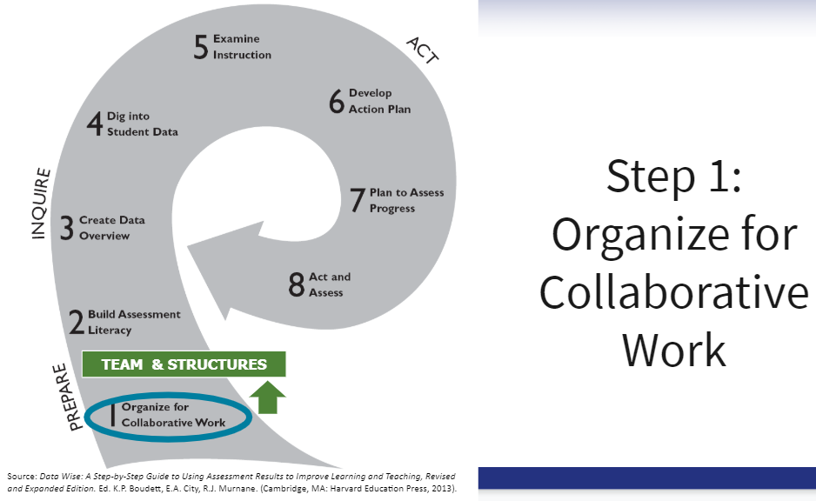
Notes:
The base of the curving arrow in Figure 1 is extra wide because substantial foundational work must take place as a school prepares to engage in data inquiry. The purpose of Step 1 is to establish collaborative teams and structures that will enable educators to work together productively. This step involves adopting an improvement process, building a strong system of teams that communicate efficiently, and protecting time throughout the year for these teams to work. It also includes clarifying expectations for effective meetings, agreeing to norms for collaborative work, and acknowledging work style preferences. Finally, it entails creating a data inventory and an inventory of all the instructional initiatives already underway at a school, because no improvement effort happens in a vacuum.

Slide 27
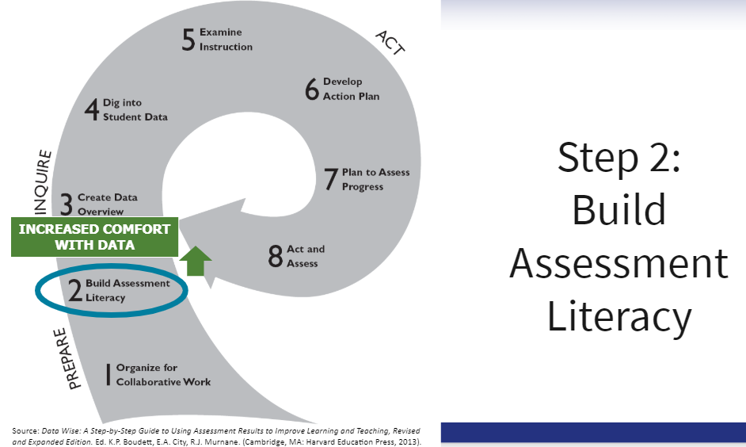
Notes:
The purpose of this step is to increase staff members' comfort with the kinds of data they will be using throughout the inquiry process. Key tasks here involve reviewing the skills that will be tested on the assessments students will take and considering how these skills compare with the broader domain of skills and knowledge students need to master. Teachers also need to learn the principles of responsible data use and to practice studying assessment results

Slide 28
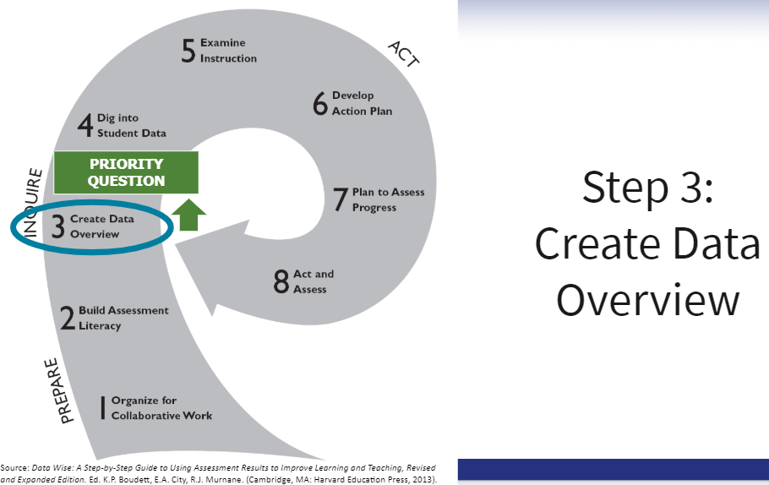
Notes:
At this step, collaborative inquiry really begins as a broad faculty group identifies a priority question that members are committed to exploring. Typically, a small group of educators, such as the leadership team, conducts a thorough analysis of recent data pertaining to a focus area and finds a pattern—or "story"—they believe is important for the entire faculty to think about. They display the data in a few charts that make it easy for their colleagues to see the story. School leaders then engage teachers in making sense of the charts and identifying a specific question they want to dig into.

Slide 29
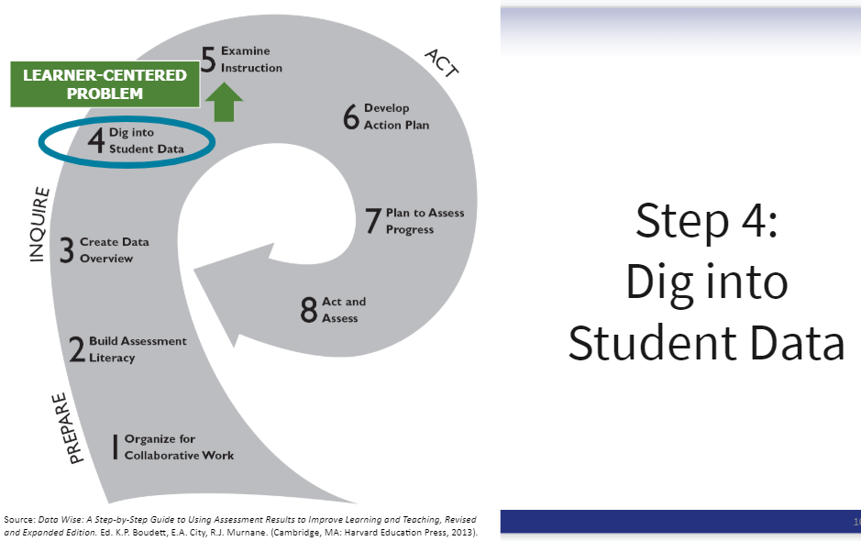
Notes:
Once a priority question is chosen, the purpose of subsequent meetings is to identify a learner-centered problem that directly relates to that question. This involves examining and analyzing a wide range of data in the target area, including student work samples, performance on benchmark assessments, observations of students, or conversations with them about their learning. From these sources of evidence, teachers come to a shared understanding of what the data show about students' learning and identify a common learning challenge.
When digging into student data, many learning challenges often surface. Instead of getting hung up trying to find "the" learner-centered problem, the trick is to select "a" learner-centered problem that, if solved, would be an important step forward

Slide 30
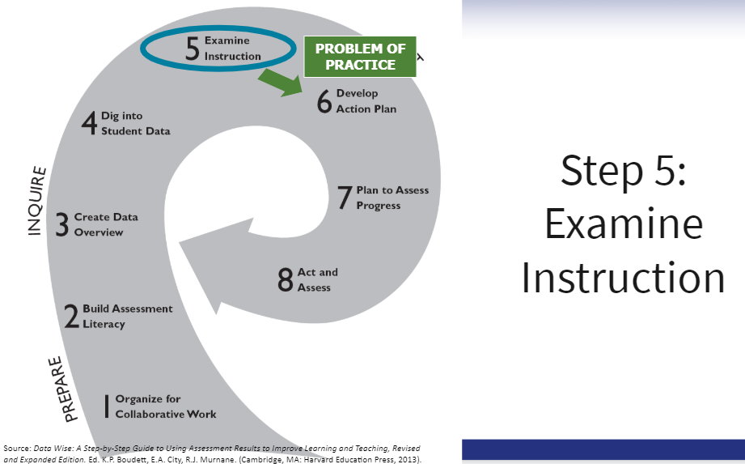
Notes:
Once data teams begin to examine instruction, their main objective is to articulate a problem of practice that may be contributing to the learner-centered problem. Key tasks at this point include examining a wide range of instructional data (including lesson plans, assignments, and assessments) and observing teachers in classrooms. Teacher teams conduct these observations. Although administrators may sometimes participate, when they do so, it's always with the understanding that the objective isn't to evaluate a teacher's practice for accountability purposes but to reach a shared understanding of what's happening in classrooms.

Slide 31
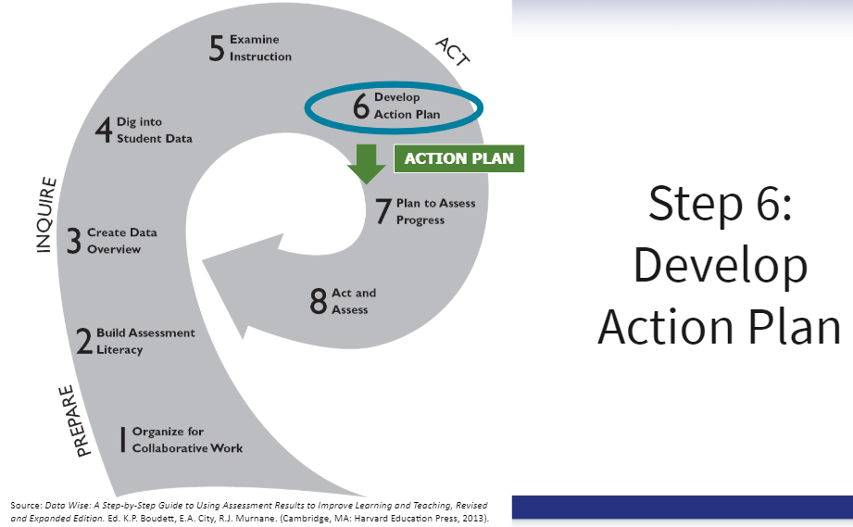
Notes:
At this point, educators create a complete, concise action plan for addressing the problem of practice. This work involves deciding on an instructional strategy, agreeing on what that strategy will look like in classrooms, and putting the plan in writing

Slide 32
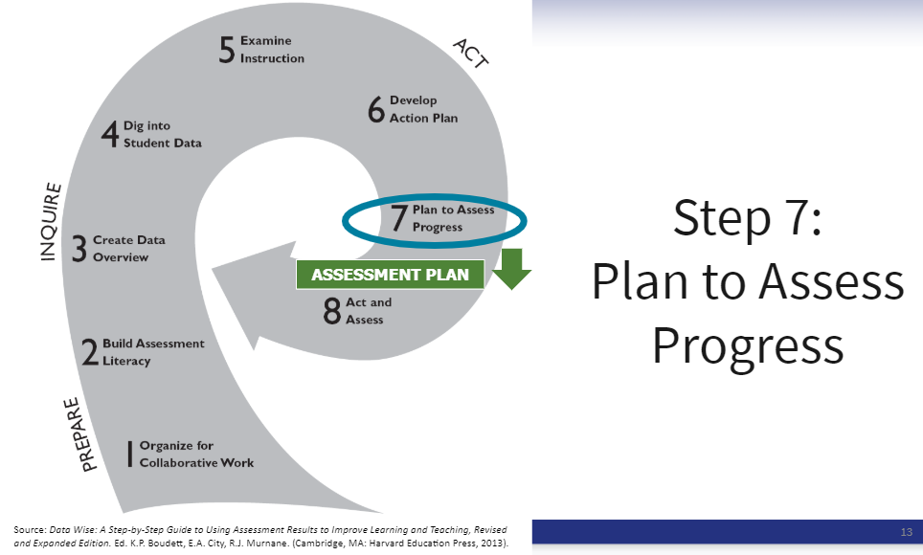
Notes:
The purpose of meetings at this stage is to identify the short-, medium-, and long-term data sources teachers will use to evaluate how the changes they implement will affect student learning. This work includes setting student learning goals for each type of assessment.

Slide 33
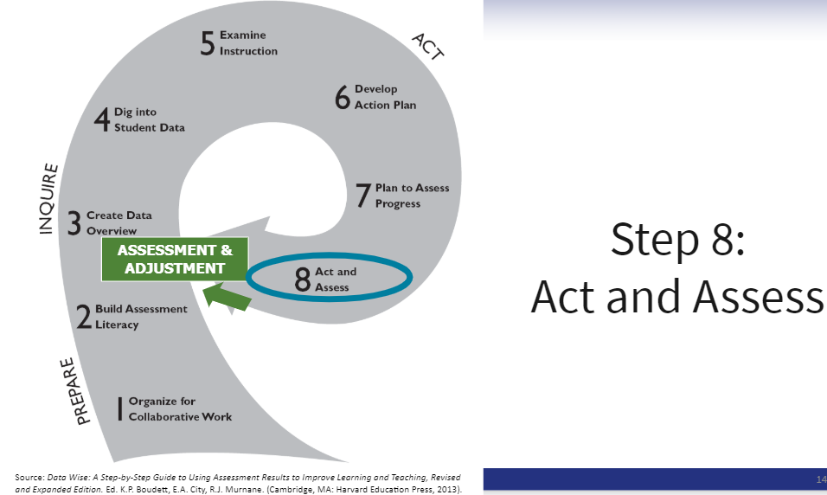
Notes:
Now it's time for team members to carry out the action plan and for teachers to assess the extent to which they are doing what they committed to, and whether student learning goals are being met. Inevitably at this stage, the team must make adjustments to the action plan or the instructional strategies; once those adjustments have been made and teaching and learning are clearly improving, it's time to celebrate the success of using data to fuel change

Slide 34
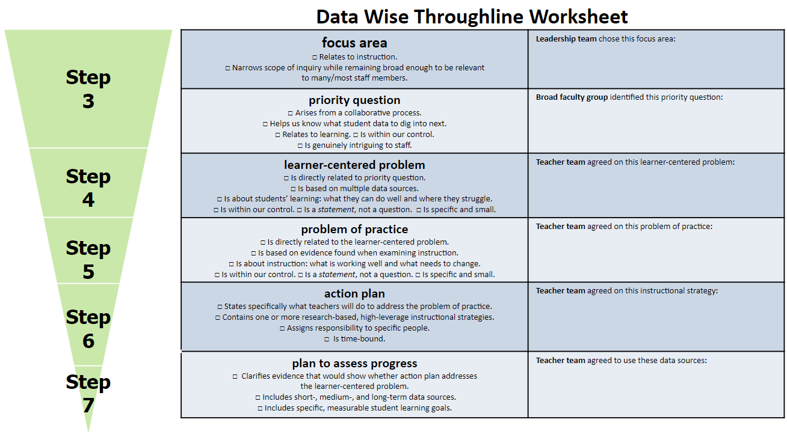
Deliverables at Each Step
Notes:
This is your looking ahead moment, where your team will go after building habits and knowledge in step 1 and 2.
Wonder and notice? Steps 1 and 2 are infused through the rest of the process
As you work through the process, this throughline sheet will guide your work to ensure it stays aligned to the focus area and the data

Slide 35

DataWise Step 1:
Organize for Collaborative Work

Slide 36
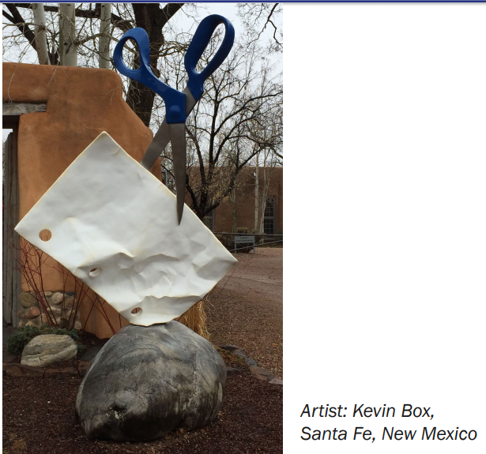
Rock, Paper, Scissors

Slide 37
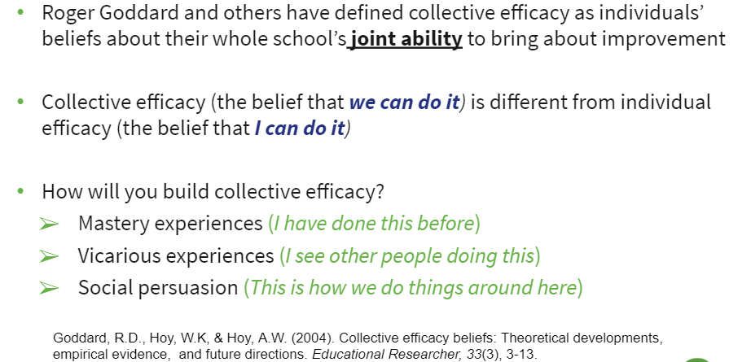
Collective Efficacy

Slide 38
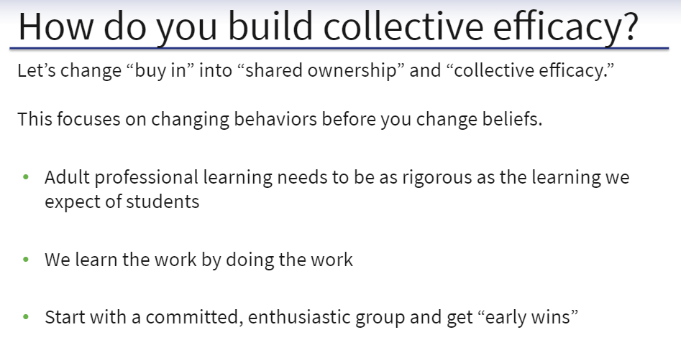
Notes:
A highlight of this slide is focusing on changing behaviors before you change beliefs. Some of what we will work to establish as we implement Step one are habits (behaviors) that we can exhibit to begin to build intentional collaboration, which will promote greater improvement.

Slide 39
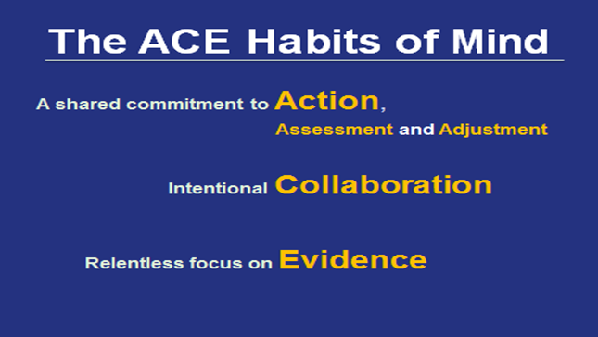
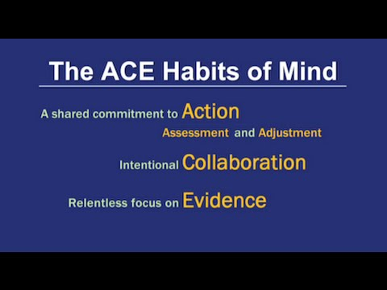
The ACE Habits of Mind
Notes:
ACE Habits of Mind are the goal; the following - norms, agenda and ladder of inference are ways to get there
As you watch the video of the ACE Habits of Mind, write:
•How each habit is defined
•What resonates with you
•How the video adds to your understanding

Slide 40

Action, Assessment, and Adjustment
Clear objectives and action steps for meetings
Continuous assessment of progress
No shame in adjustment
- Analysis paralysis
- Forging blindly ahead
- Jumping into action too quickly
Notes:
The “A” of the ACE Habits of Mind relates to “Action, Assessment and Adjustment”. Teams should pay close attention to potential pitfalls when focused on the “A” - taking too long to analyze, and then subsequently not coming to action in a timely manner, forging ahead without examining enough data, and jumping to action prior to really examining the core - student data and instruction.

Slide 41
Intentional Collaboration
Deliberate choices about how/when to engage people in the work
Structuring conversations to leverage collective wisdom
- Assuming that TEAMS = IMPROVEMENT
- Grouping people in the same room = Productive
Interaction
Notes:
When we think about collaboration we acknowledge its power. The “C” of the ACE Habits of Mind is collaboration… but the key here is that collaboration be INTENTIONAL. Teams make deliberate choices about how and when to engage people in the work and use structures to establish respect and trust.
CAUTION!!! Just because a team is established does not mean that interactions will be productive and lead to improvement. The collaboration must be intentional - a bit later we will share some strategies for promoting intentional collaboration.

Slide 42
Relentless Focus on Evidence
Adhere to norm of grounding statements in evidence
Make decisions based on specific and descriptive statements based on a wide range of evidence
- Culture of nice
- Jumping to conclusions
- Passing judgement on others
Notes:
The “E” of the ACE Habits of Mind is a relentless focus on EVIDENCE. Often, when groups start working together they are used to providing a ton of “warm” feedback, and shy away from having conversations about areas of need/challenge. When we keep these conversations grounded in evidence, the conversations feel less personal, become less about passing judgment, and more about the evidence.
So…. how can we start to cultivate the ACE Habits of Mind? What are some strategies we can use to begin to establish these habits?

Slide 43

Data Wise Norms
What did you mean by “about what can be expected?”
Take an inquiry stance
Ground statements in evidence
Assume positive intentions and take responsibility for impact
Stick to protocol and hear all voices
Start and end on time
Be here now
Expect non-closure
Expect discomfort in the service of learning
My teammate wants the best for children
This Photo by Unknown Author is licensed under CC BY-SA
www.gse.harvard.edu/datawise
43
Notes:
The first strategy that ILTs can use to begin to cultivate their ACE Habits of Mind is following a set of norms. Now, this isn’t necessarily new to many teams, but we have adopted this set of norms to be used minimally for ILT meetings. They are a combination of norms put forward by the DataWise process, but also include norms encouraged by the book “Courageous Conversations about Race”, and used by the the RCSD’s REAL Team - Racial Equity Advocacy Leadership team - that promotes racial equity throughout the District. Use of norms can ensure that the team works efficiently, builds trust and respect through norms like starting and ending on time, “being here now” and assuming positive intentions, and helps to keep discussions grounded in evidence.
Using statements like “tell me more” and “what do you mean by that” allow for the speaker to explain their thoughts
Walking through this process, it took the team some time to adjust to Sticking to the protocol/meeting agenda and be here now
As we begin to shift our minds into this frame of thought, we realize that there will be transition and some uncomfortability; however, if we can ask that you trust in this process and give it a chance...it allows for much to be accomplished in our very limited time

Slide 44

DataWise Norms
Open Discussion
How do you/your team feel about committing to norms?
What concerns do you have about committing to norms?
What ideas do you have for supporting one another in following norms?
Notes:
So….. let’s take some time to reflect on this. Have a discussion with your elbow partner and be ready to discuss with the whole group.

Slide 45
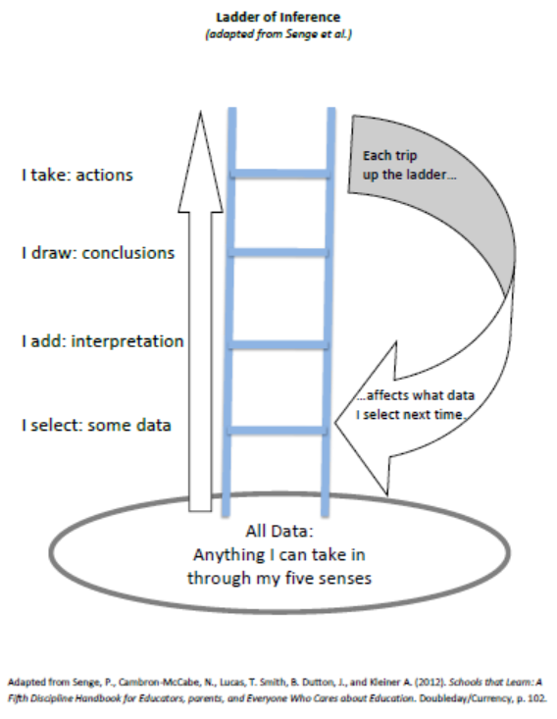
Ladder of Inference
Video
Notes:
How do we keep each other grounded in evidence? One way we can do this by using the ladder of inference. This short video will take us through the ladder and provide us with some examples of a team using the ladder to ensure their conversation stays grounded in evidence.
Play video.

Slide 46
Ladder of Inference
PROBLEM
Suppose that, as you walk into a colleague’s classroom, the following thoughts race through your head. Place the following statements where they belong on the ladder of inference, one statement per step.
A. The teacher should engage in training on how to actively engage students in learning.
B. Students have put their heads on their desks because they are bored.
C. Six students have their heads on desks.
D. The teacher is not effective at generating enthusiasm for learning.
Notes:
Now it’s your turn to practice with the ladder of inference. (Refer to handout in folder).
Read the problem on the slide. Place each statement A - D on the ladder of inference where you think it falls.
KEY -
A - actions
D - conclusions
B - interpretation
C - data

Slide 47
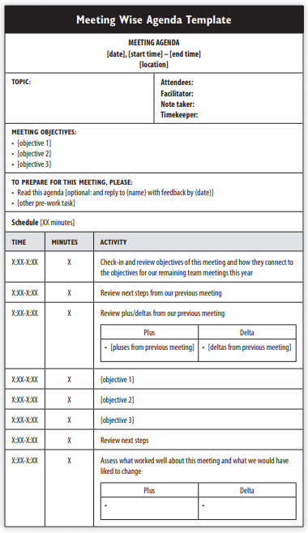
Meeting Wise Rolling Agenda
Template
Notes:
Another strategy we can use when cultivating the ACE Habits of Mind is using a consistent agenda, which delineates a different team member for each of several roles including facilitator, notetaker, timekeeper and norm checker.
The agenda is prepared in advance of the meeting, and roles can rotate. Also, it’s a “rolling” agenda, so the template continues to be copied and added to the end in order to keep the work of the team all in one spot, and to allow for those who may be absent to review what the team accomplished during their absence.
We will have a chance this afternoon to practice using the rolling agenda, complete with teams assigning a member to each role.

Slide 48
Meeting Wise Rolling Agenda
What is a rolling agenda?
A Google Doc agenda that contains agenda meeting notes and objectives on one continuous document.
Benefits
Collaborative communication
Clear record keeping
Organizes images, websites, and notes in one place
Allows for reflection
Provides structure and focus for each meeting
Stores all meeting notes in one place so members can access at any time

Slide 49
Additional Learning
All Principals and Assistant Principals should have received a copy of Data Wise and Meeting Wise to support this work. Please let the facilitator know if you need copies.
Professional learning will continue throughout the year at Principal and Assistant Principal meetings.
The Massive Open Online Course (MOOC) is available to all who would like to participate https://www.edx.org/course/introduction-to-data-wise-a-collaborative-process-to-improve-learning-teaching-2

Slide 50
Goals
SHORT TERM (End of Sep)- ILT
MID-TERM (End of November)- Norms, Rolling Agendas, ACE Habits of Mind
LONG TERM (June 2020)- One cycle through the Data Wise Improvement Process by June 2020

Slide 51
Team Time Rolling Agenda
Please have one member of your team access a copy of your rolling agenda for “Team Time” via this link:
bit.ly/rcsdtpd
Once a member of your group has created a copy please share it with the other members of your group.
Directions on creating your own Shared drive (formerly Team Drive) for your ILT will follow
Notes:
bit.ly/rcsdtpd

Slide 52
THANK YOU!!!

